Slide 1
INTRA IIT TECH 1.0
Age and gender detection

Slide 2
PROBLEM / TASK
Most existing digital video surveillance systems rely on human observers for detecting specific activities in a real-time video scene. However, there are limitations in the human capability to monitor simultaneous events in surveillance displays. So we deicded to build a solution/model to estimate the gender and age of people from a surveillance video feed(like a mall, retail store, hospital etc.).

Slide 3
Dataset
HIGH RESOLUTION HUMAN FACES: This dataset was used to train the pre-processing model that will convert low resolution image into high resolution image.
UTKFace Dataset: This dataset was used to train our final model as it contains 20000 images of different kinds and generations of human faces with corresponding labels.
VGG16: The weights of pre-trained VGG16 on the ImageNet dataset was used in prediction part
ESRGAN : The weights of pre-trained esrgan were used in pre-processing part.

Slide 4
OVERVIEW
THE WHOLE PROJECT IS DIVIDED INTO 2 PARTS
THE FIRST PART IS PRE PROCESSING
SECOND PART IS PREDICTION

Slide 5
PRE PROCESSING
The main objective of pre processing is to convert a low resolution image into a high resolution image and pass this image to prediction part.
The mains tools/methods used in this preprocessing
Transfer Learning
ResNet

Slide 6
Model Architecture
The whole pre-processing model is divided into 2 parts. One is for upscaling the low resolution image to higher resolution image and the second one is to improve the details in the image.
Input images
Upscaling
Improving the details
High resolution image

Slide 7
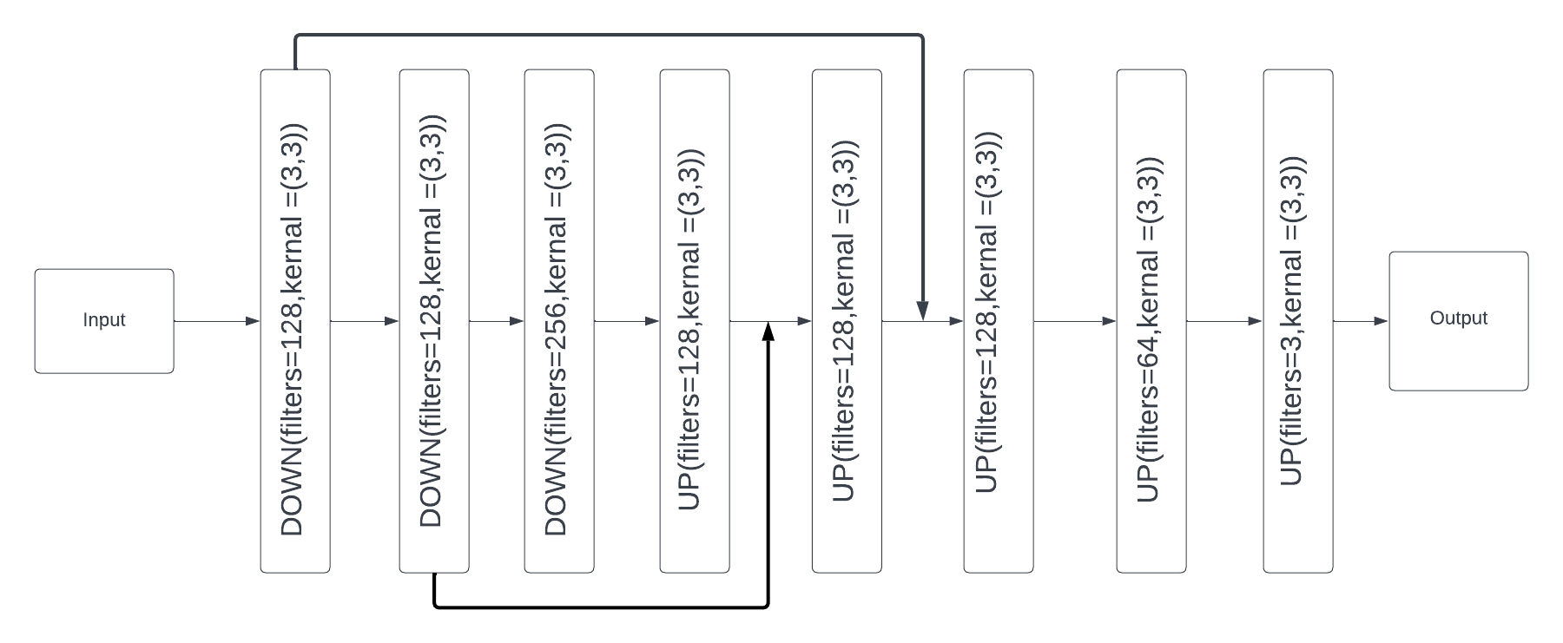
Upscaling model Architecture

Slide 8
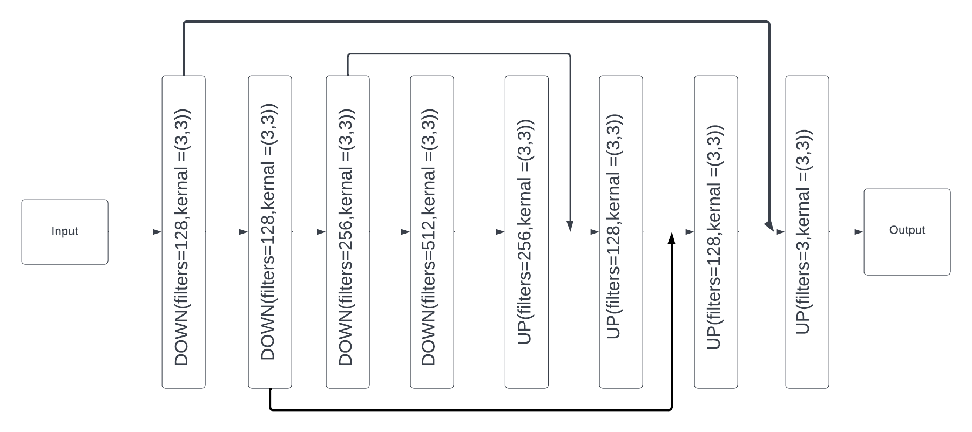
IMPROVING THE DETAILS

Slide 9
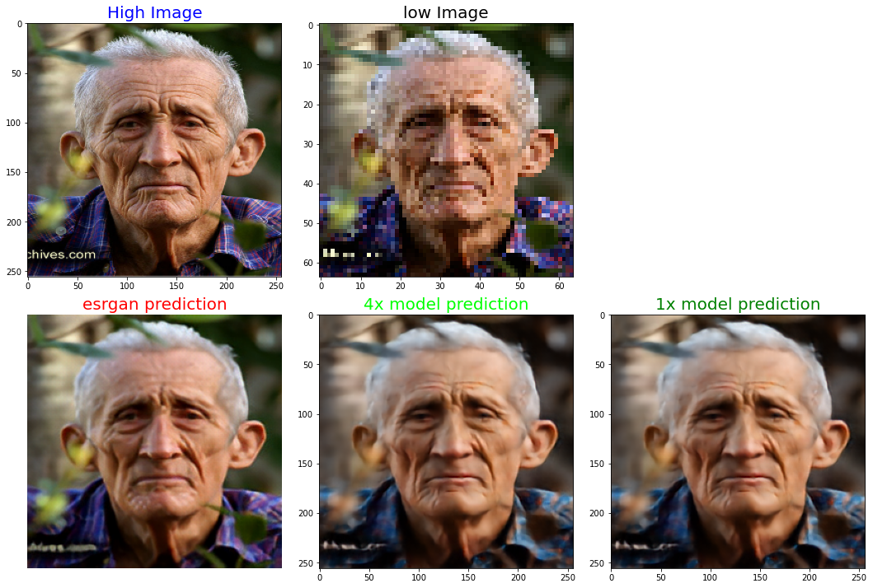
RESULTS

Slide 10
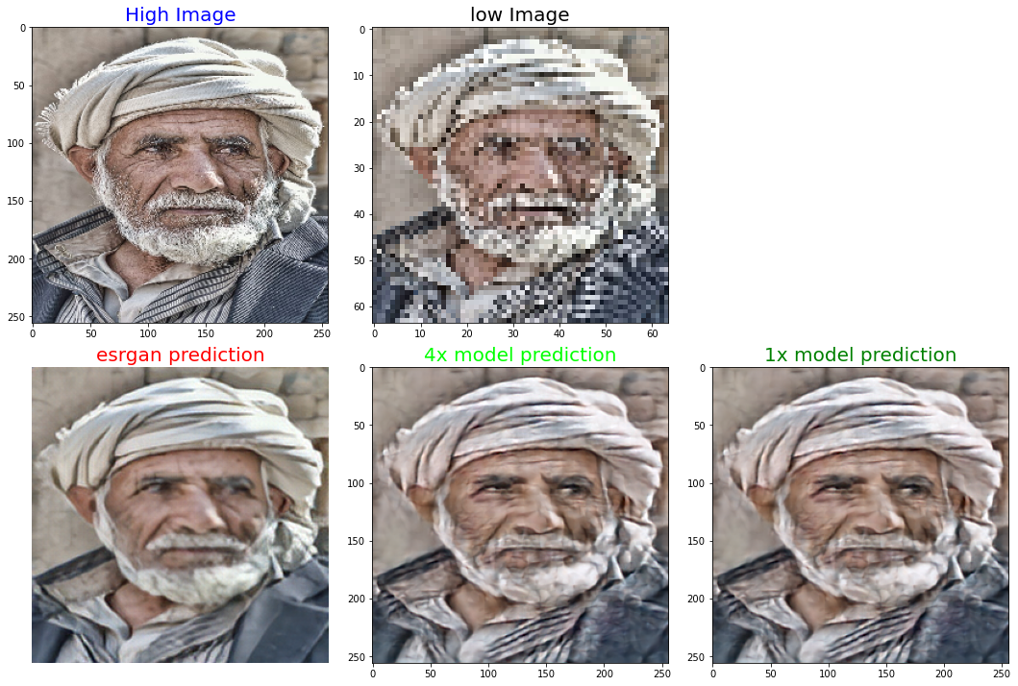
RESULTS

Slide 11
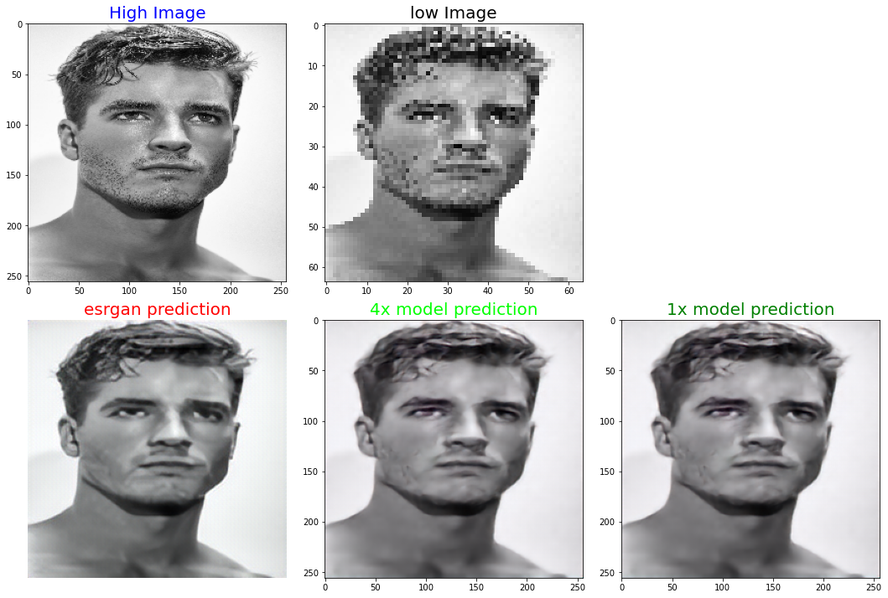
RESULTS

Slide 12
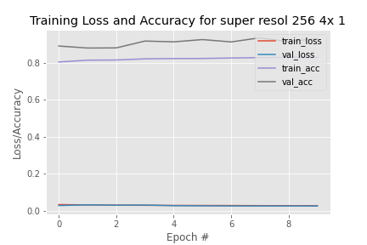
RESULTS

Slide 13
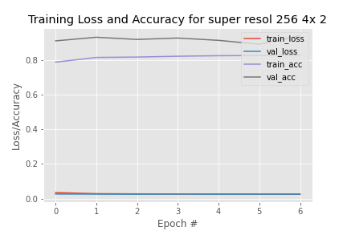
RESULTS

Slide 14
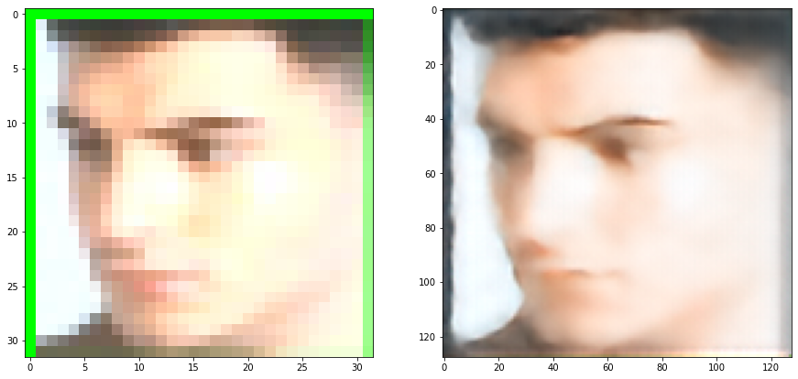
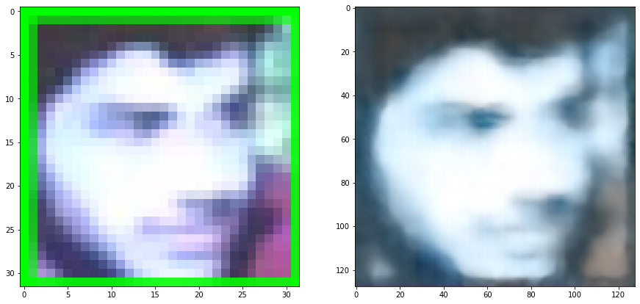
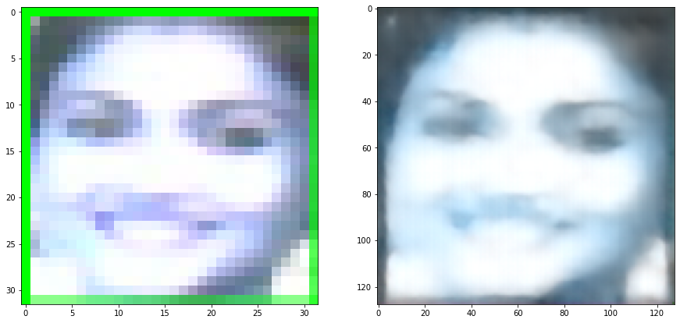
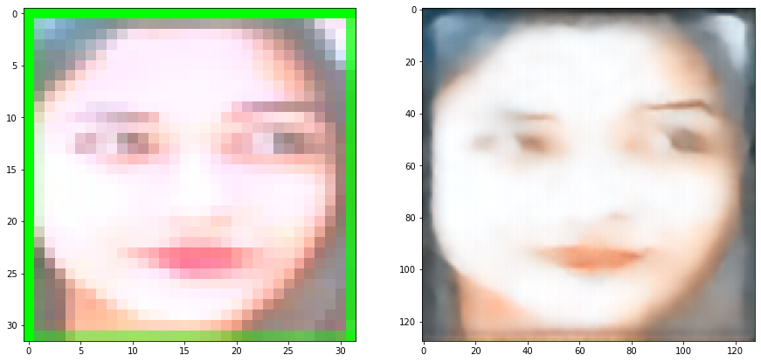
RESULS

Slide 15
PREDICTION
It involves Transfer learning method for creation of baseline.
Involves two major parts:
Feature-Net
Convolutional Neural Network(CNN)

Slide 16
Baseline Model: Feature-Net
Extracts and uses intermediate features from pre-trained VGG-16 and use them as Hypercolumns
The input for this section would be High resolution human faces images.
The features of these images would be extracted and presented by Hypercolumns.

Slide 17
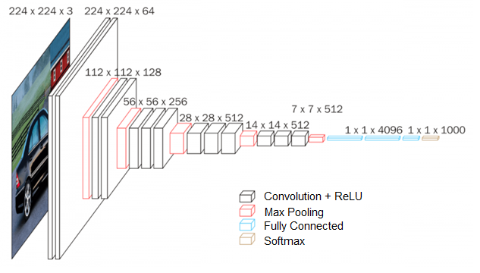
VGG16 Architecture

Slide 18
Baseline Model:CNN
Uses the hypercolumns as input to a small CNN.
The output of this network will be binary/multi class classification layer .
Loss function was Categorical Crossentropy between the true and predicted values.

Slide 19
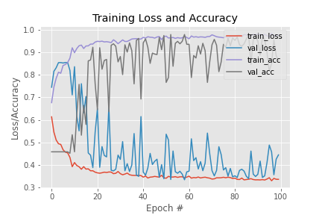
Results

